Slide 1
Product and engineering
Key processes

Slide 3
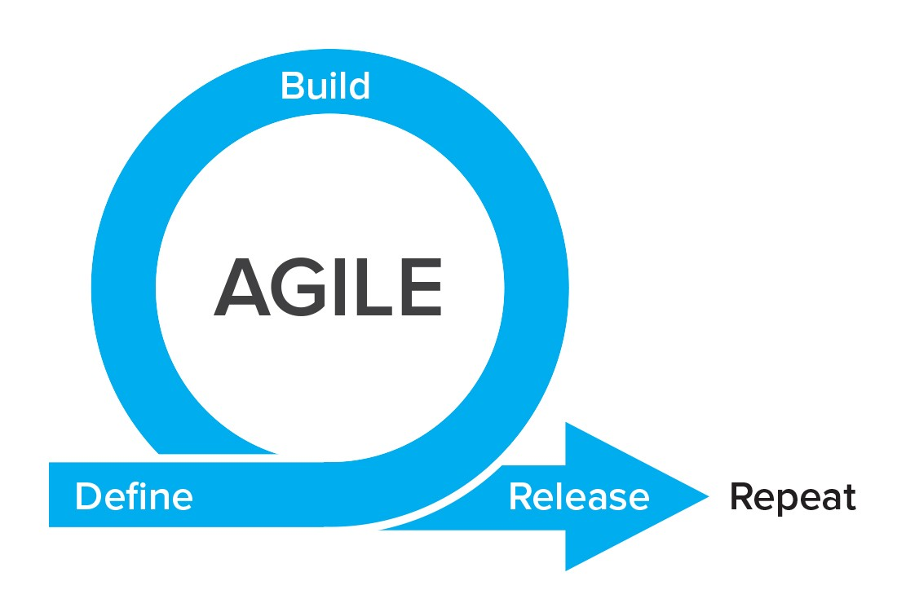
KOKO product / engineering processes
New software projects (checklist template)
Roadmapping (not covered)
Scoping process
Handover process
Delivery process
Software releases (checklist template)
Planning
Execution Management
Product and Technical support
Issue resolution

Slide 4
New software projects
Scoping, handover and delivery

Slide 5





Scoping process
Business stakeholders
Requirement Gathering (User Journey, Product, Feature, Function)
Sign Off - New Product / Feature Document
Product team
Develop feature specifications
Technical needs assessment
Engineering team
Vision and goals
Business value
Customer value
Improvements/impact on existing features
Timing consideration
Cost constraints
Target operational KPIs
Links to existing features
Constraints and risks
Phasing needs
Flows discovery
User experience
System requirements
Data / monitoring requirements
Process mapping
Architecture impact
Backwards compatibility
Build/customise/buy
Review by stakeholders
Key interactions and discussions
Outputs and tools
Gap Analysis and High-Level tech solution / Cost Benefit Analysis / Budgeting
Final
Requirements Document (Detailed)
Final
Product /
Feature Roadmap
Requirements Document High-Level
Proposed Product / Feature Deck
Business Process Mapping
Notes:
Questions:
At what point do we decide in this process that something is going to get built.
When do we decide to buy versus build.
When do we consider RoI
Does this process update the overall product roadmap in other areas
What are the possible outcomes in this process - not a done deal that this results in a set of internal build requirements?
Where do vision and user needs definition fit in
Tools selection is not fixed and will depend on the feature and scope, so what is fixed here?
How do we develop guiding principles around the choices to buy or build software

Slide 6



Handover process
Eng team (incl QA)
Review requirements in detail with team
Create engineering designs
Walk through with team lead
and QA lead
Agree project can be taken into sprints according to DoR
Product team
Review to
allocate a team
Requirements clarifications
Acceptance tests creation
Eng management
Feature walkthrough
Architecture consideration
Skills needs
Business timing
Value to KOKO and users
Use case walk through
Areas of concern/uncertainty
How to demonstrate
Functional tests
Non functional tests
Deployment and release needs
Relative feature priority
Team lead does walk through
Implementation considerations
Functional and non functional test improvements
High level engineering design
Team needs and estimation
Acceptance test agreement
Component changes
Unit test scenarios
API or interface changes
Logical flows
Edge cases
Database schema impact
Estimation recheck
Review of outputs
DoR met?
DoD understood for eng team?
Key interactions and discussions
Outputs and tools
Update requirements
Create stories & estimate
Create zephyr tests
Document designs
Refine estimations
Allocate team
Add execution time
Refine execution time
Notes:
Walk through with team lead to incorporate: sharing handover docs to read offline, then meeting to discuss and jointly creating the story backlog to discuss each requirement and acceptance criteria in detail
Review feature with engineering team: team lead presents the feature to the engineering team. Meeting can further refine requirements with the team and add additional implementation information / concerns to the story details
Handover needs:
Articulate the value of what’s being built
Product owner needs to have felt the key needs of the feature have been understood
Engineering team needs to have understood the value(s) of the feature, areas of risk to test early, key things to be demonstrated and in what order
Acceptance tests are locked in
Questions
What documentation is mandatory (None) but checklists of concerns need to be
Why do we have two separate transfer meetings PO-Team lead, Team lead -> Team
When do we define tests

Slide 7



Delivery process
Clarify missing testing requirements and give progress demos as agreed
Demo of completed work to stakeholders
Product team
Engineering team
Plan sprint, creating subtasks where required, taking into consideration PO demo needs
Development of features and unit tests
Integration to release codebase
QA verify
AT execution and results
Eng management
Design, unit test and code structure check-ins
Assignment to team members
Development strategy
Branching approach
Derisking approach for uncertain elements
Key unit tests
Pairing
Peer review
Unit testing
Story testing
Acceptance clarifications with QA by developers
Merging constraints
Integration testing
Acceptance testing
Verification of test outcomes
Key interactions and discussions
Outputs and tools
Add stories to sprint board and assign team members
Update design docs
Code reviews as needed
Merge branches for release
Notes:
Notes
Big change from now is QA only testing acceptance criteria at the end
Frequent reviewing / demos needed in the case of UI heavy features
How does feature testing coincide with sprints? -> Answer: it doesn’t need to, but best if it does through good planning.

Slide 8
Software releases
Planning and execution management

Slide 9

Release planning
Eng team (incl QA)
Focus on tactical steps in preparation for release
Update and refine release concerns
Product team
Discuss and agree key release concern areas
Ensure the features are delivering intended value
Stakeholders
Operations affected
Key people to be informed
Training material needed
Conflicts arising
Adoptino planning
Implications from design
Confirm acceptance criteria cover scope
Discuss delivery risks
Agree and give demos
Draft release notes
Key regression tests Prepare training material Train trainers
Initial functionality checks
Periodic follow-ups
Document follow-on requirements
Adoption feedback
Key interactions and discussions
Outputs and tools
Scoping
Handover
Delivery
Adoption follow ups
Notes:
Walk through with team lead to incorporate: jointly creating the story backlog to discuss each requirement and acceptance criteria in detail
Review feature with engineering team: team lead can further refine with the team and add additional implementation information / concerns to the story details

Slide 10

Release execution management
Eng team (incl QA)
People and tools preparation
Deployment sheet preparation
Release testing
Deployment
Closing release
Product team
Stakeholders
Agree RM
Define QA Lead
Set up communication lists and tools
Collate release notes
Create run sheet
Populate deployment steps
Define NOC steps
Define smoke tests
Define post deployment actions
Create Zephyr test cycle
Agree timelines
Confirm story completion Communicate timelines
Send out release notes
Update on progress
Coordinate bug fixes
Notify company
Coordinate deployment
Ensure users are happy
Close projects in common tools
Key interactions and discussions
Outputs and tools
Release notes
Runbook
Checklist
Release tests
Backward compatibility
Runbook
Checklist
Notes:
Release run sheet
Release checklist

Slide 11
Testing - what do we test when and why?
Acceptance Testing (feature)
Release Testing (stage)
Smoke Testing (prod)
Project A
ATs
+ RTs
ATs
+ RTs
ATs
Project B
ATs
Release Candidate
Production
Project C
ATs
Project D
ATs
Live
Acceptance testing is done during the project delivery phase, initially by developers using the acceptance tests defined by QA during handover, with outcomes verified by QA on completion of delivery phase.
The purpose of acceptance testing is to confirm new features are working per their requirements, but may include some regression tests where there is a known impact on existing features.
Release testing is done by QA on a Release Candidate created from several new projects that have been merged. The set of tests is agreed between PMs and the QA team during delivery of the projects being released.
The purpose is to discover issues in areas of overlap between projects to cover existing features more extensively. Consequently the release tests may consist of a mixture of project acceptance tests and regression tests.
Smoke testing is a post deployment selection of tests that are run by QA and other departments, to check the deployment process has run successfully. The set of tests is determined by QA with input from PMs
The purpose of this testing is to discover any unexpected issues that may have occurred during the prod build or deployment process.
Can the test be done earlier?

Slide 12
Product & tech support
Issue resolution

Slide 13

Issue resolution
Eng team (incl QA)
Tech support engineer leads troubleshooting
Create JIRA tickets for fully diagnosed problems
Engineer feeds back
Stakeholders
Emails Tech Support with issue
Clarifications
Product
Escalation if urgent
PM on support assists tech support
Characterise issue
Document observations
Resolve immediate problem for user
Tagging issue to a project epic or NPW epic
Review of problem frequency
Review of impact
Identify missing processes
Improve workflows for operational departments
Priority vs new features
Documentation updates
Priority vs new features
Key interactions and discussions
Outputs and tools

